Slide 1
Numerical Methods Lec 2
By
Asst. Prof. Syed Shujaat Hussain
(Fall 2023)

Slide 2
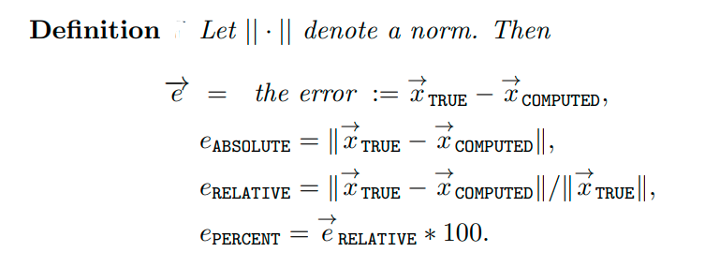
Measuring Error

Slide 3
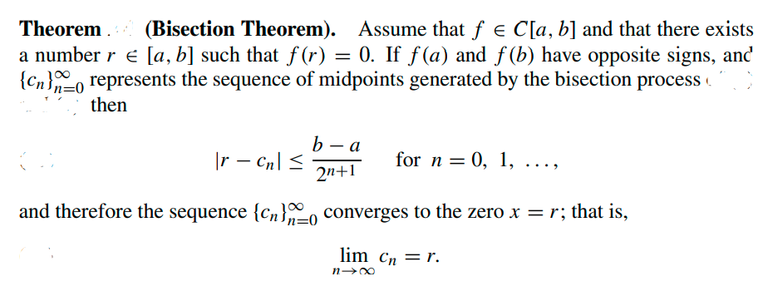
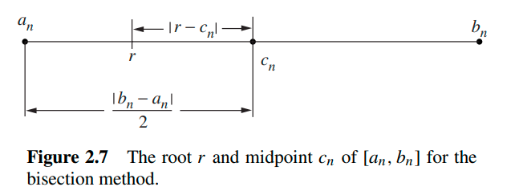

Slide 4
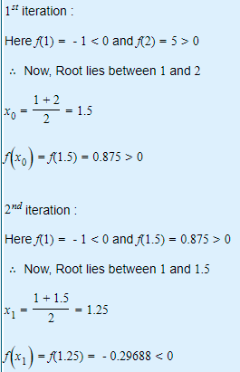
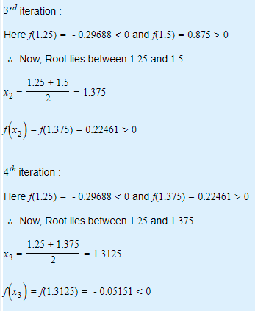
Example: Find a root of the equation f(x)=$x^{3}−x−1 in the interval [1,2]$
Solution:

Slide 5
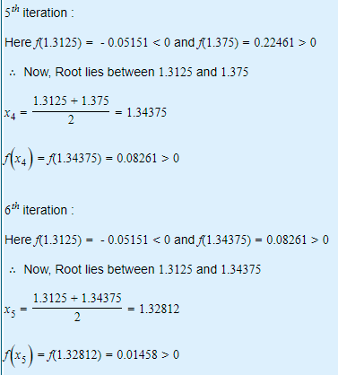
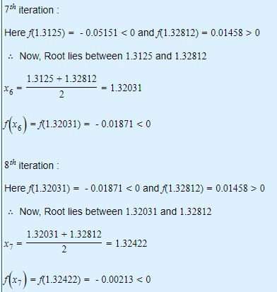
Continue
Solution:

Slide 6
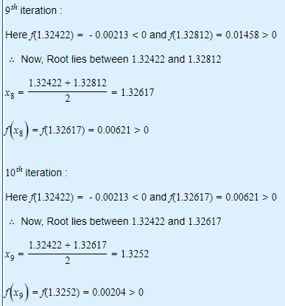
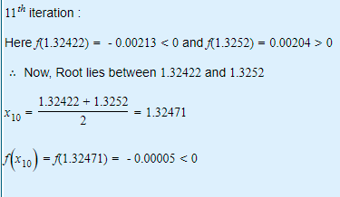
Continue
Solution:

Slide 7
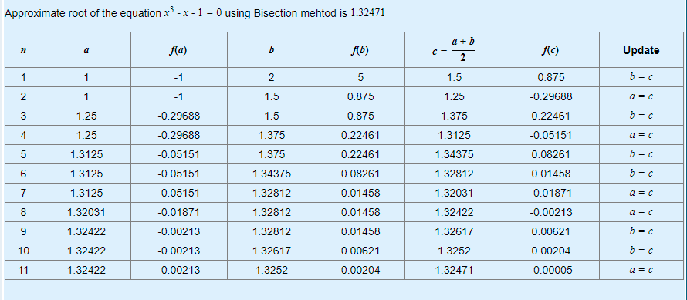
Result

Slide 8
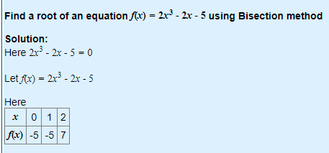
Class Activity

Slide 9
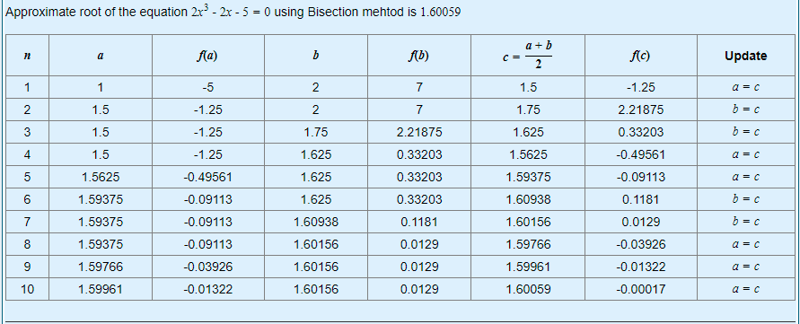
Solution

Slide 10
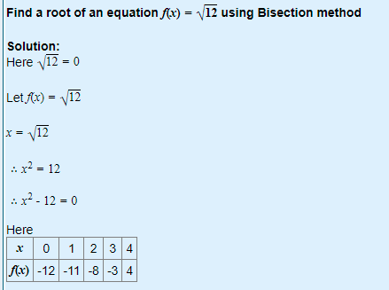
Class Activity

Slide 11
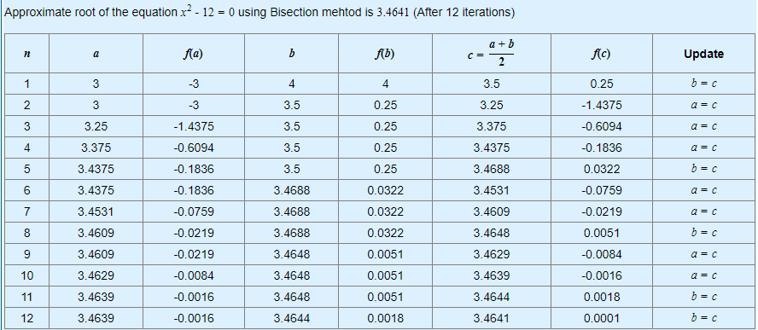
Solution

Slide 12

Test your ability!
Q Where do the curves y$=Cosx$ and y=x³-1 intersect? Use Bisection
method up to five iterations in the interval [1,1.5]

Slide 13
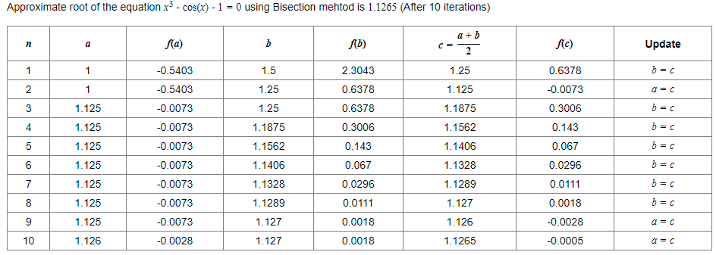
Solution

Slide 14
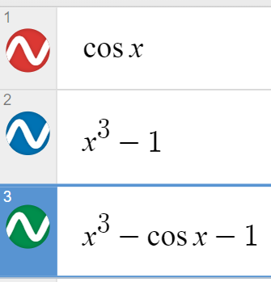
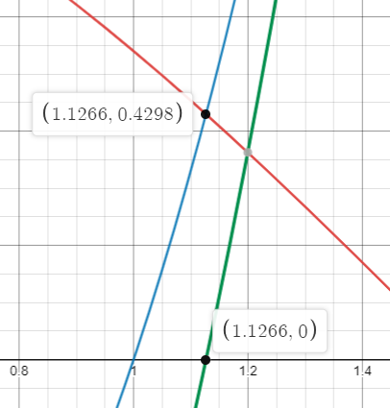
Graphically
So

Slide 15

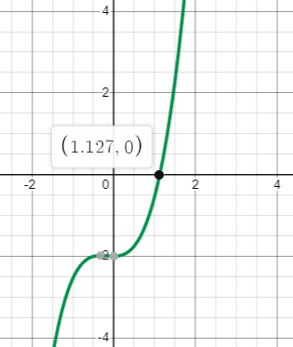
Graphically
The root can be observed on graph.

Slide 16
Iteration for Solving x = g(x)= Φ(x)
A fundamental principle in computer science is iteration.
A process is repeated until an answer is achieved. Iterative techniques are used to find roots of equations, solutions of linear and nonlinear systems of equations, and solutions of differential equations.
A rule or function g(x) for computing successive terms is needed, together with a starting value p₀ ( Fix Point )

Slide 17
Finding Fixed Points
Definition: A fixed point of a function g(x) is a real number P such that P = g(P).
Geometrically, the fixed points of a function y = g(x) are the points of intersection of y = g(x) and y = x.
Definition: The iteration P_{n+1} = g( P_{n} ) for n = 0, 1, ... is called fixed-point iteration.

Slide 18
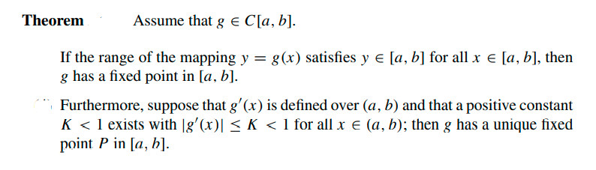
Existence of a fixed point and Convergence of the fixed-point iteration process to a fixed point.

Slide 19
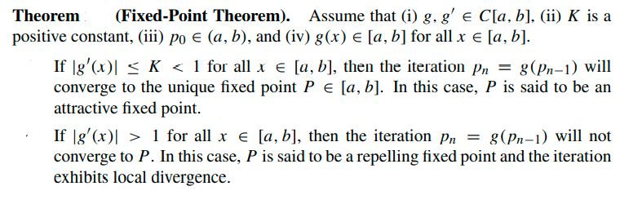

Slide 20
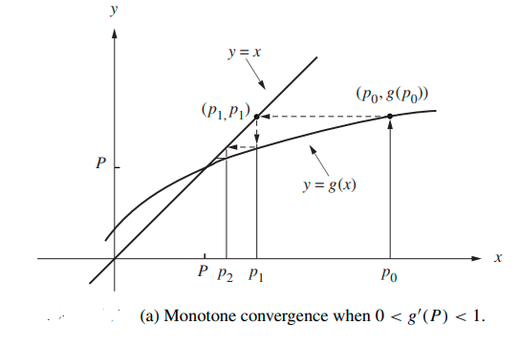
Graphical Interpretation of Fixed-Point Iteration

Slide 21
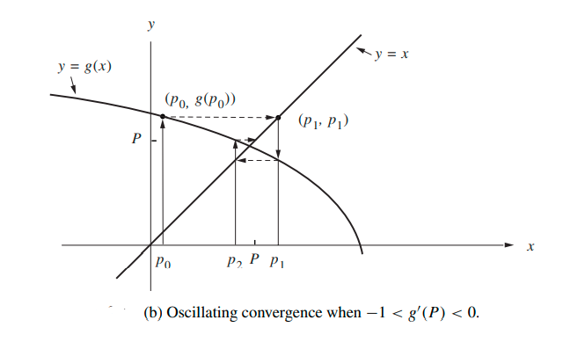
Graphical Interpretation of Fixed-Point Iteration

Slide 22
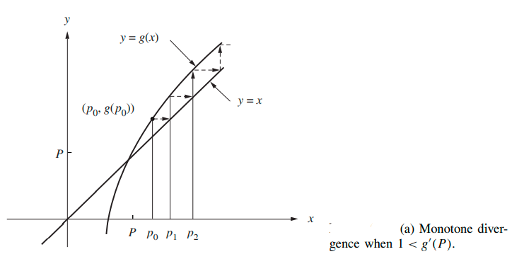
Graphical Interpretation of Fixed-Point Iteration

Slide 23
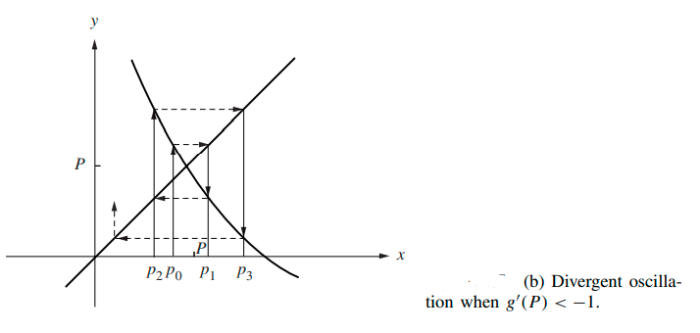
Graphical Interpretation of Fixed-Point Iteration

Slide 24
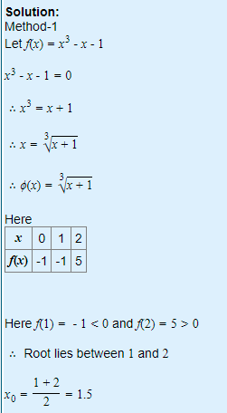
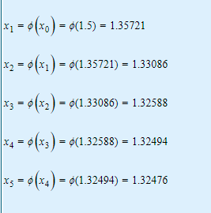
Q: Solve f(x)=x³-x-1 by fix point iteration.

Slide 25
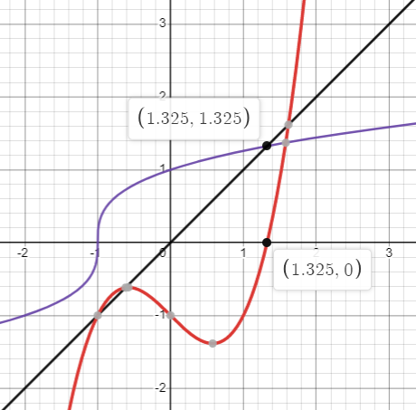
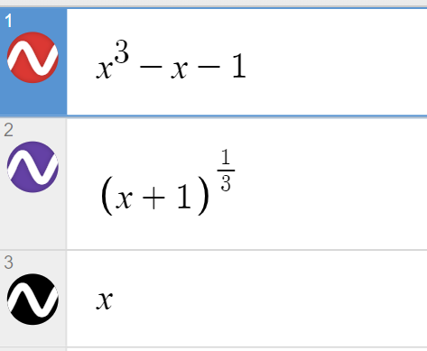
Fix point iteration Converges

Slide 26
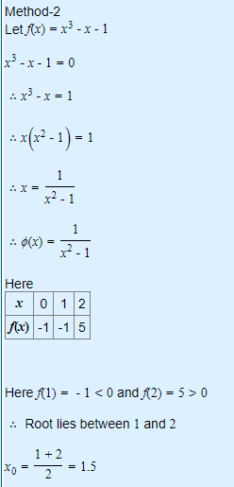
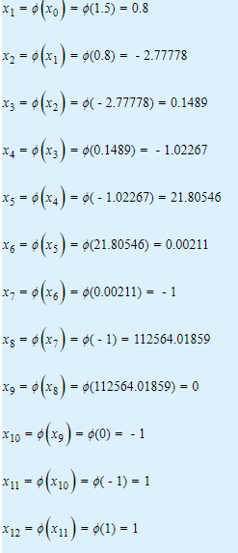
2nd way: Which diverges

Slide 27
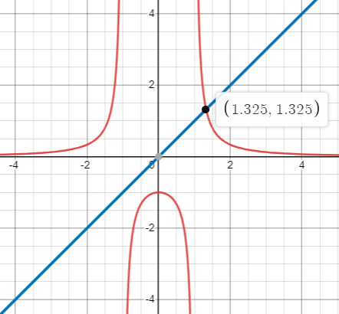
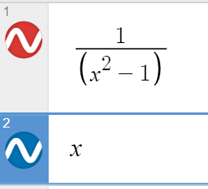
Fix Point iteration method diverges

Slide 28

Class Activity
Q.
(Take $x_{0}=0.1$ as a starting point)

Slide 29
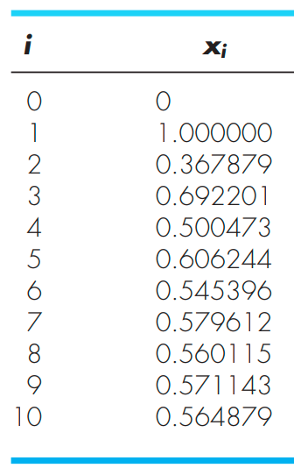
Iterations Results

Slide 30
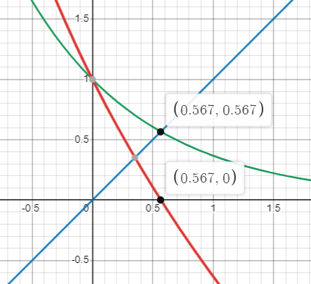
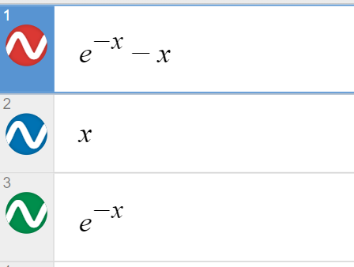
Graphical representation of solution

